Slide 1
From Coding to Cluster
Raymond Norris

Slide 2
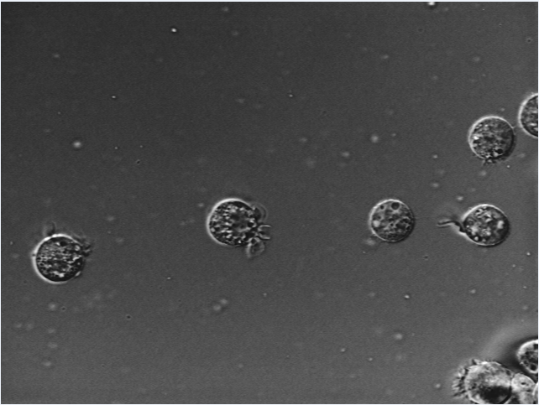
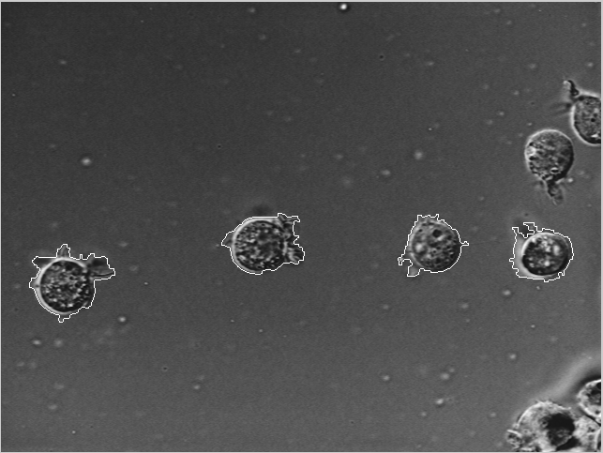
Cell Detector

Slide 3
Code Path
jobScript
tissueDriver
MAT-File
batchProcessingFiles(@alg,files)
TIF
detectCells

Slide 4
Running the Code Locally
Open MATLAB somewhere
Change directories to my sandbox
>> local_tissueDriver
Can't find tif files because only the relative filename was provided, not absolute. Either provide full path or add tif folder to MATLAB path.
Can't save results MAT-file because output folder doesn't exist. Create output folder.

Slide 5
Running the Code Locally in Batch Mode
>> localbatch_tissueDriver
Can't find tif files because only the relative filename was provided, not absolute. Add tif folder to MATLAB path.

Slide 6
What Needs to be Modified in Order to Run on the Cluster?
Using a script, not a function
return status or output directory
Paths are hardcoded
pass in root directory
File separator is hard coded
use fullfile
Assumes TIF file exists
check results when touching the file system
TIF files must be on the MATLAB path
add tif folder to the MATLAB path

Slide 7
What Needs to be Modified in Order to Run on the Cluster (cont.)?
Assumes output folder already exists where ever MATLAB is running
supply output directory to write to. check if folder exists; if not, create it
Results MAT-File will be overwritten next time it's run
add timestamp to filename
Changes MATLAB working directory
Track old directory, change back before leaving

Slide 8
One Time Setup on MATLAB
>> configCluster

Slide 9
Submitting the Code to the Cluster in Batch Mode
jobScript
Can be written anyway, with any filename. Just a wrapper to calling batch.
Use ClusterInfo to tailor job being submitted to scheduler (e.g. wall time, memory, etc.)
>> % Submit a job to process 1000 TIF files
>> % with 24 Workers
>> j = jobScript(23);
How do you retrieve the results?

Slide 10
ROI – How Many Workers Do I Really Need?

